Slide 1
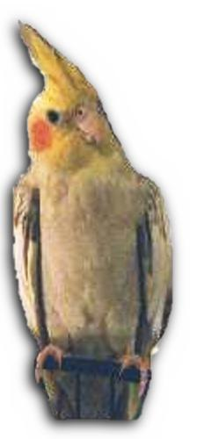
AVIAN RESCUE CORPORATION Concord, CA (925)686-2350
Federal: CFC # 64924
California State: CSECC 3301
Saving One Small Life at a Time
Notes:
Buster – Just Hanging Around

Slide 2
AVIAN RESCUE CORPORATION Concord, CA (925)686-2350
Some of the following birds shown are not available for adoption, but are used to represent the wide variety of tropical birds ARC has in its care.
ARC serves as both a Bird Rescue and a Sanctuary for birds which are not adoptable for any number of reasons.
ARC has multiple collection points within the Southwestern US
Photography copywritten by Jennifer Dillard (Albuquerque, NM) and ARC
If you have any questions, please ask…

Slide 3
Macaws in flight

Slide 4
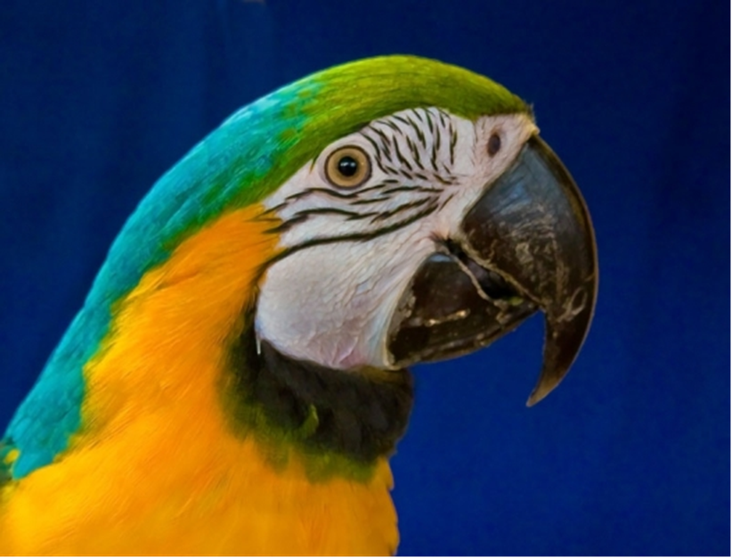
ERNIE – One handsome fella’ (Blue and Gold Macaw)
Notes:
ERNIE – One handsome fella’

Slide 5
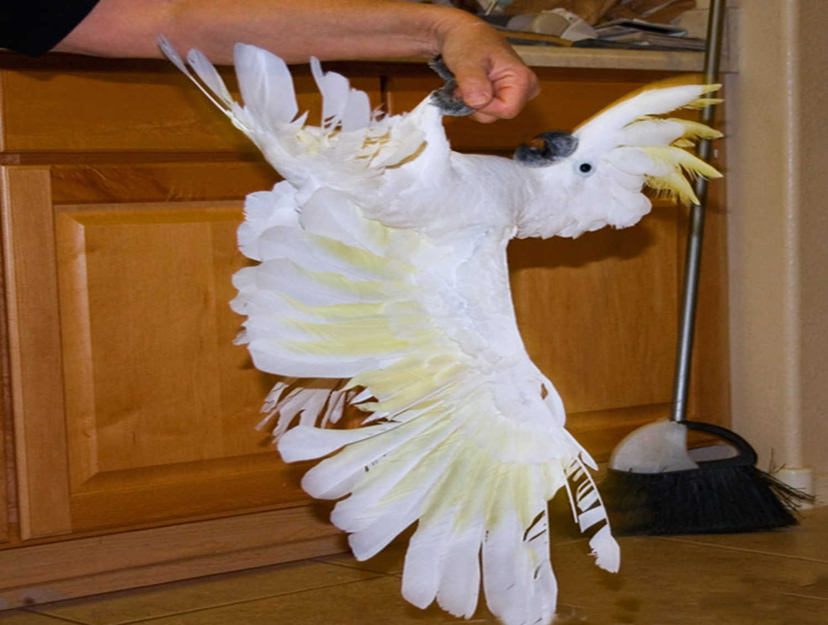
BUSTER – Just hanging around! (Eleanor Cockatoo)
Notes:
BUSTER – Just hanging around!!

Slide 6
ANGEL (Rose Breasted Cockatoo)
Notes:
ANGEL (Rose Breasted Cockatoo)

Slide 7
ANGEL – Wing tumor
Notes:
ANGEL – Wing tumor

Slide 8
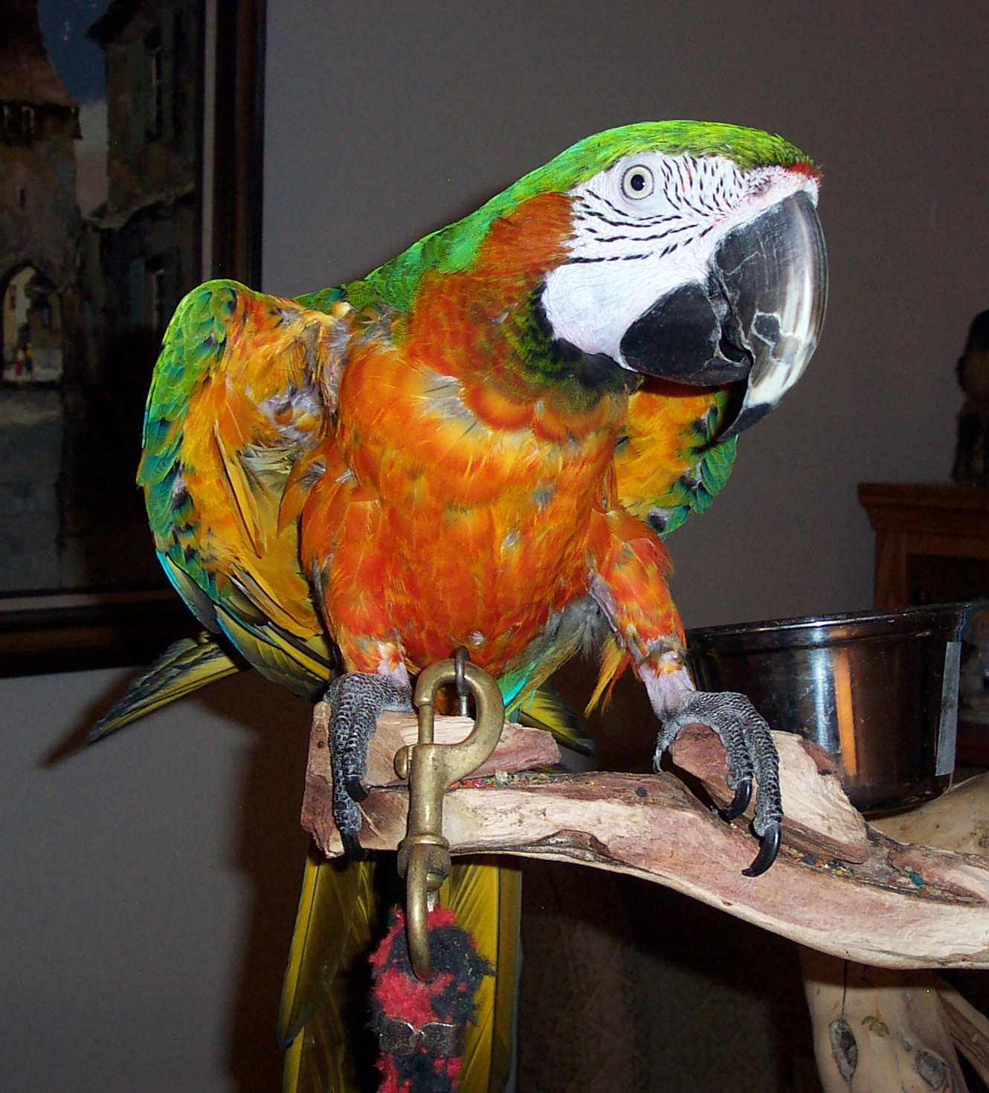
BOOMER (Harlequin Macaw) – Saying Hello
Notes:
BOOMER (Harlequin Macaw) – Saying Hello

Slide 9
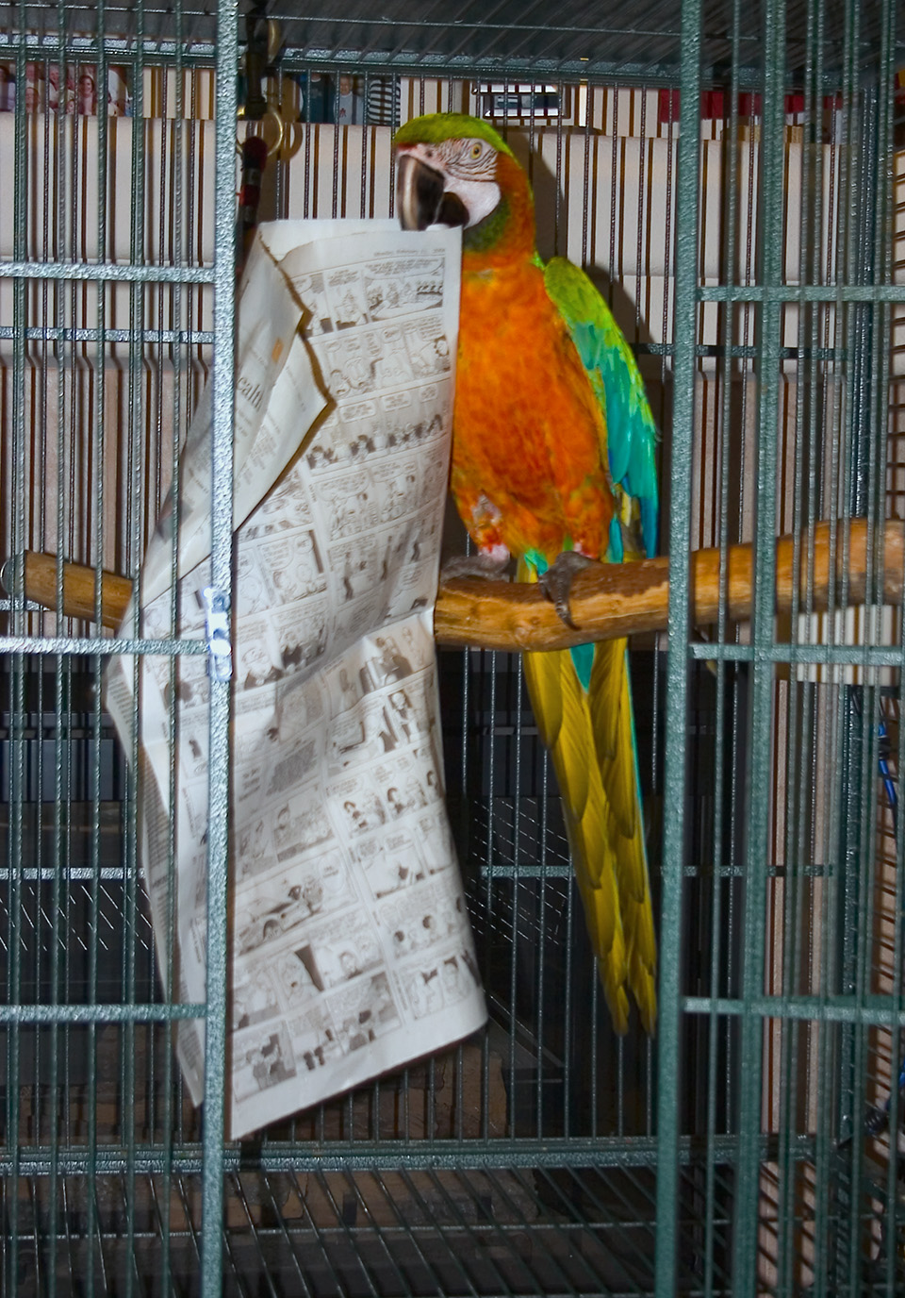
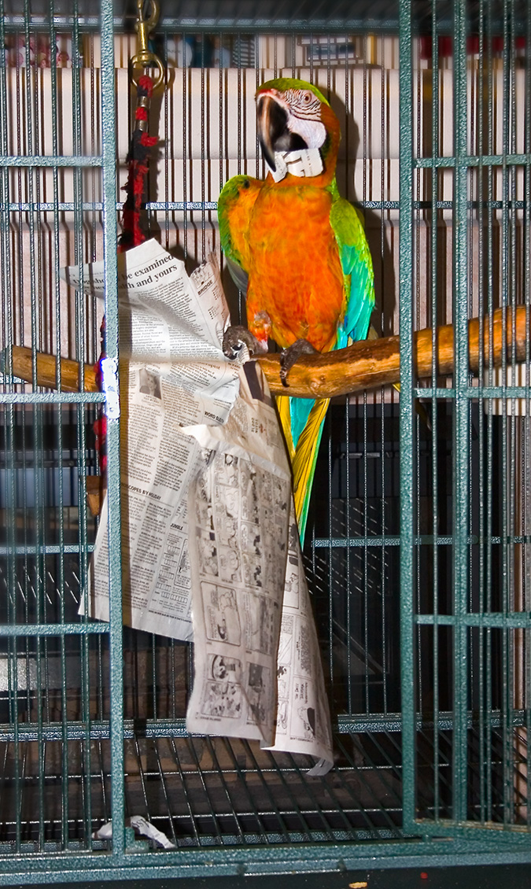
BOOMER – Reading the newspaper
Notes:
BOOMER – Reading the newspaper

Slide 10
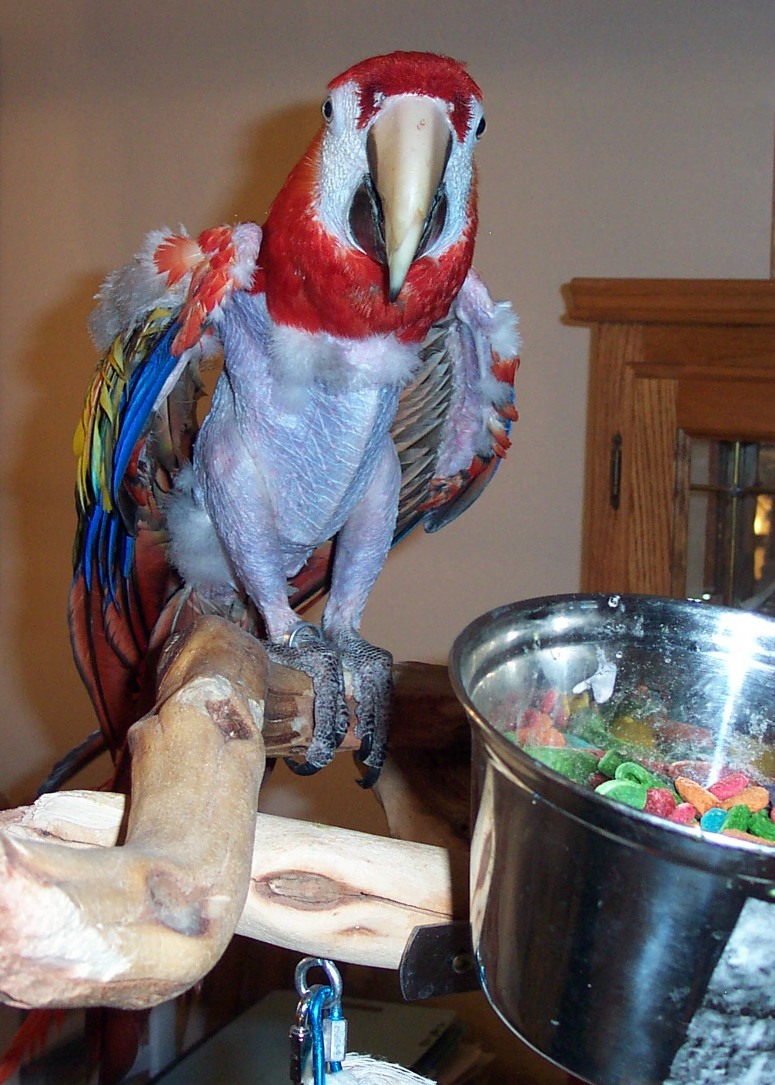
JONNIE (Scarlet Macaw)
Notes:
JONNIE (Scarlet Macaw)

Slide 11
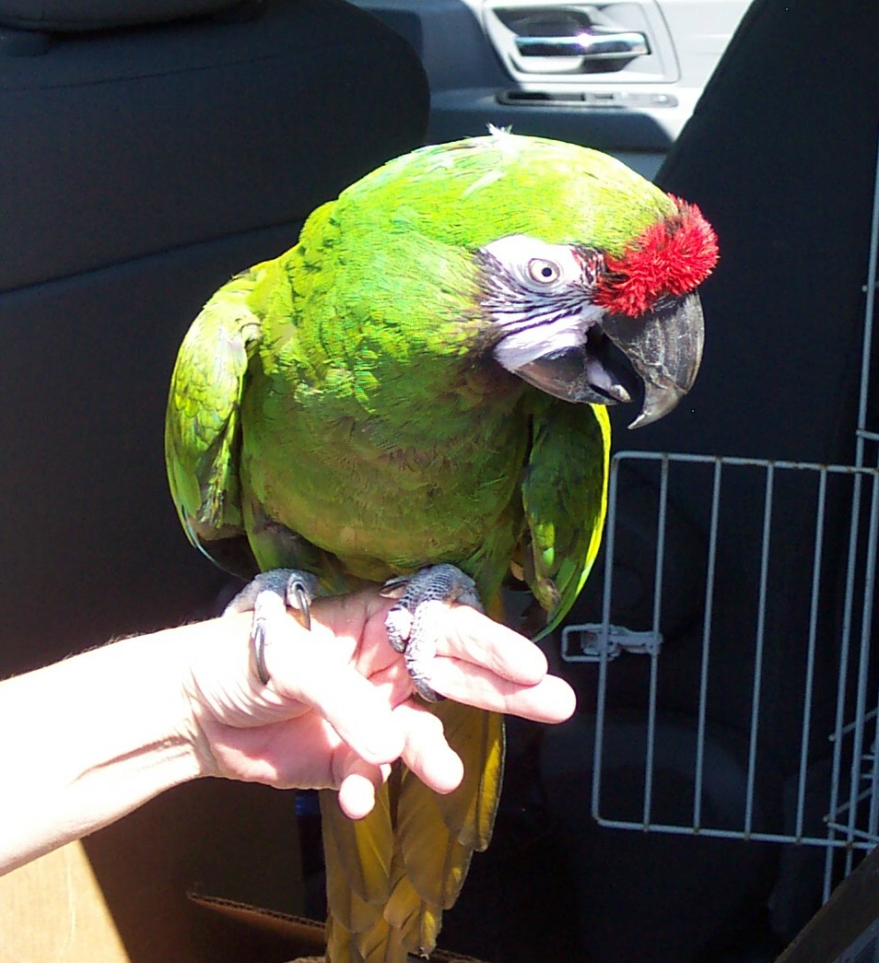
MAJOR (Military Macaw)

Slide 12
The 3 Amigos
Notes:
The 3 Amigos

Slide 13
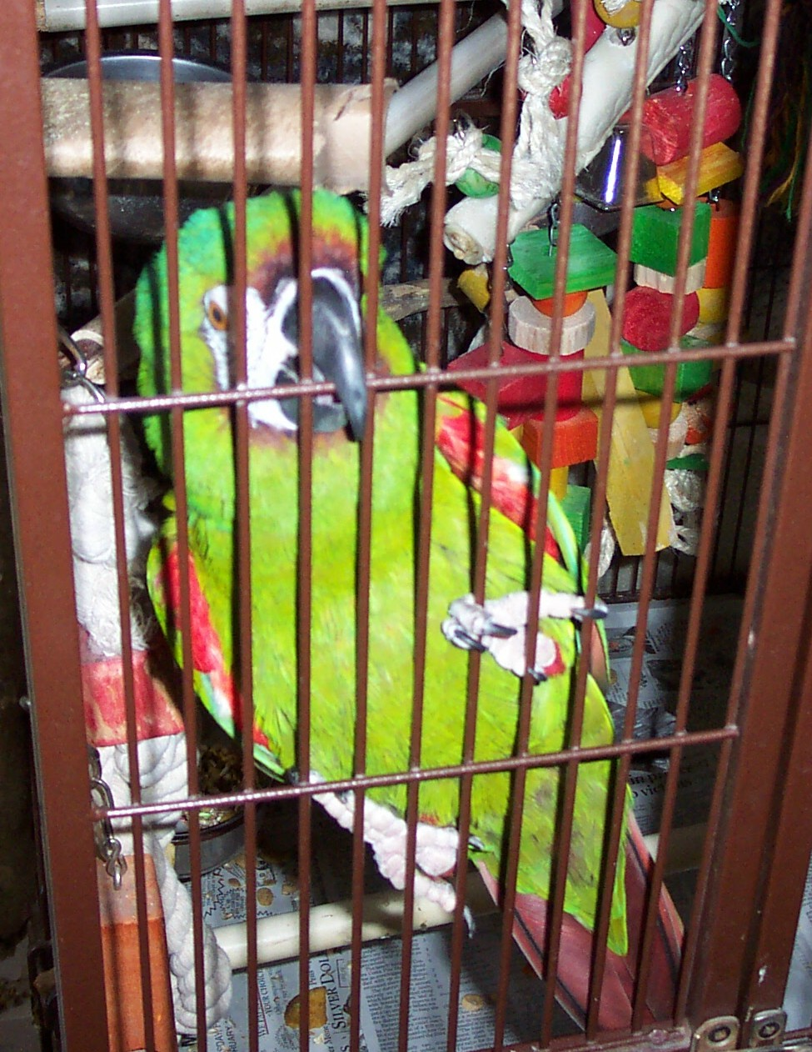
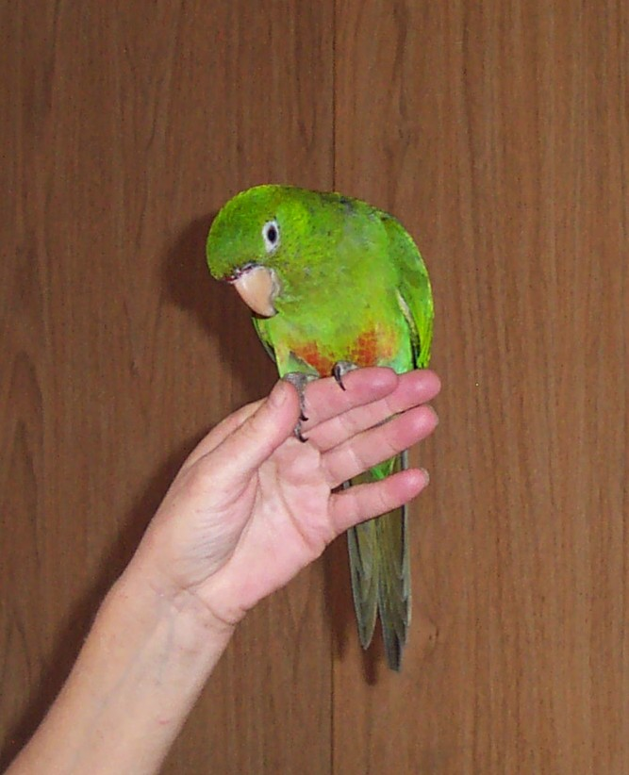
BENJAMIN (Severe Macaw) and FRISCO (Cherry Headed Mixed Conure)
Notes:
Benjamin (Severe Macaw) and Frisco (Cherry Headed Mixed Conure)

Slide 14
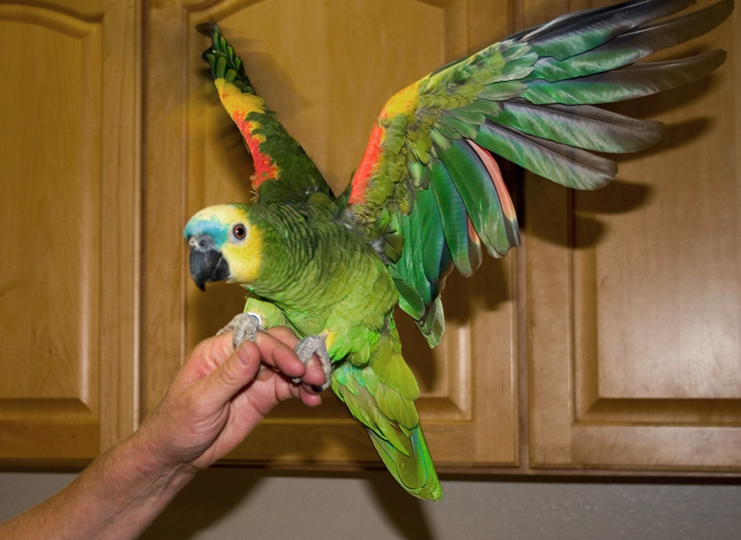
LUCKY (Blue Front Amazon)

Slide 15
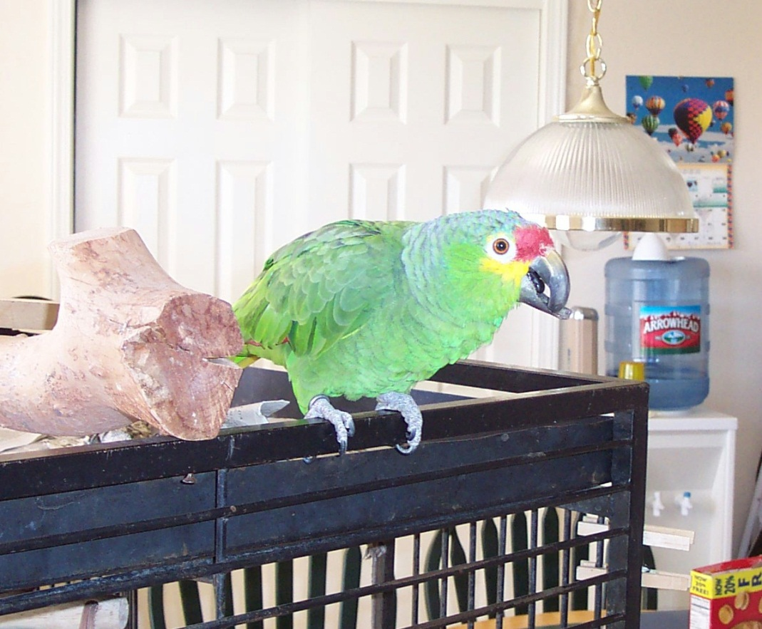
CHARLIE (Red Front Amazon)

Slide 16
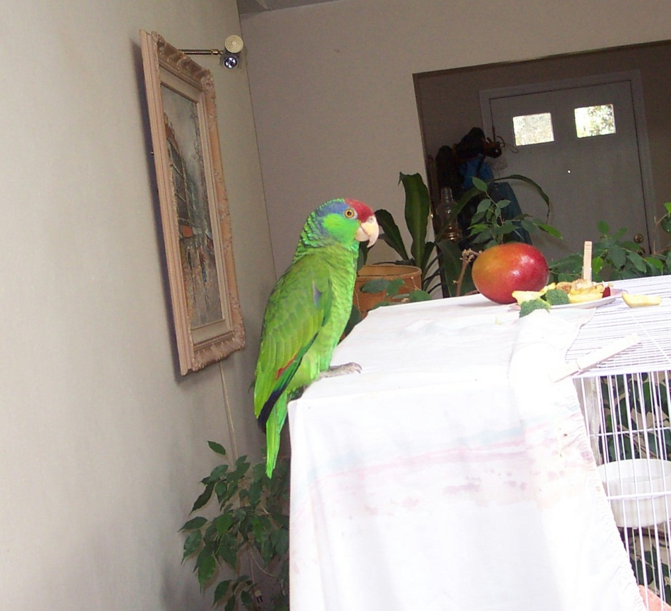
HERBIE (Mexican Red Head Amazon)

Slide 17
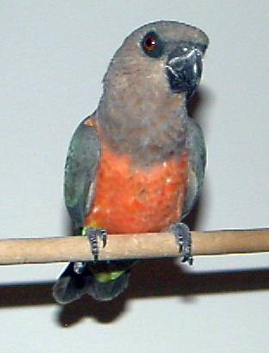
GEORGE (Red Bellie Parrot)
Adopted

Slide 18
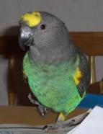
SNICKERS (Meyers Parrot)

Slide 19
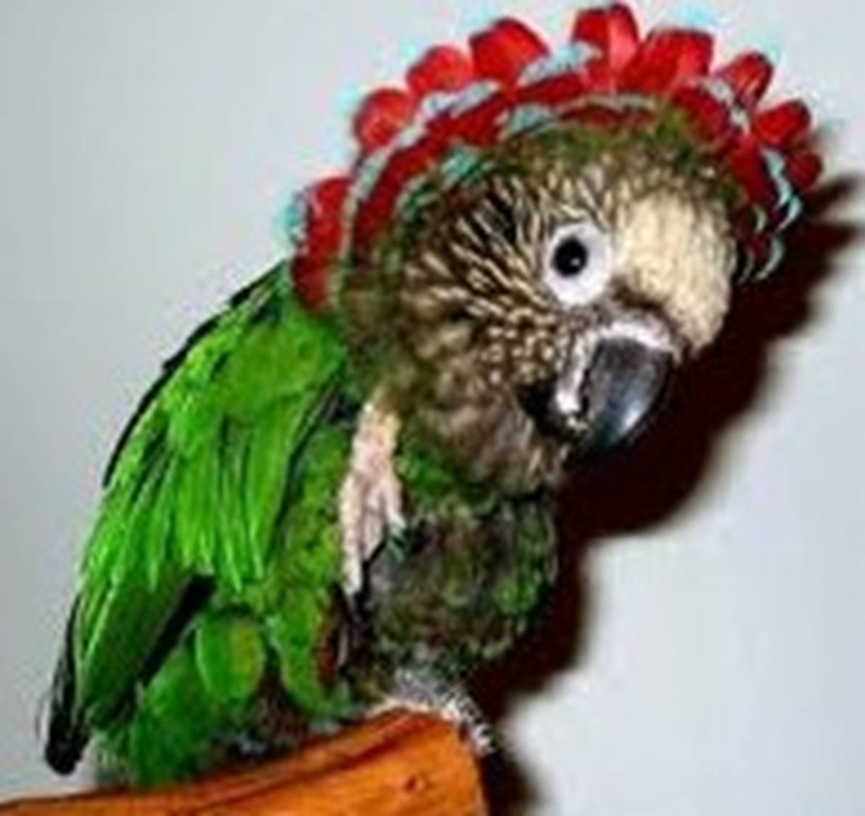
HAWKEYE (Hawk Headed Parrot)

Slide 20
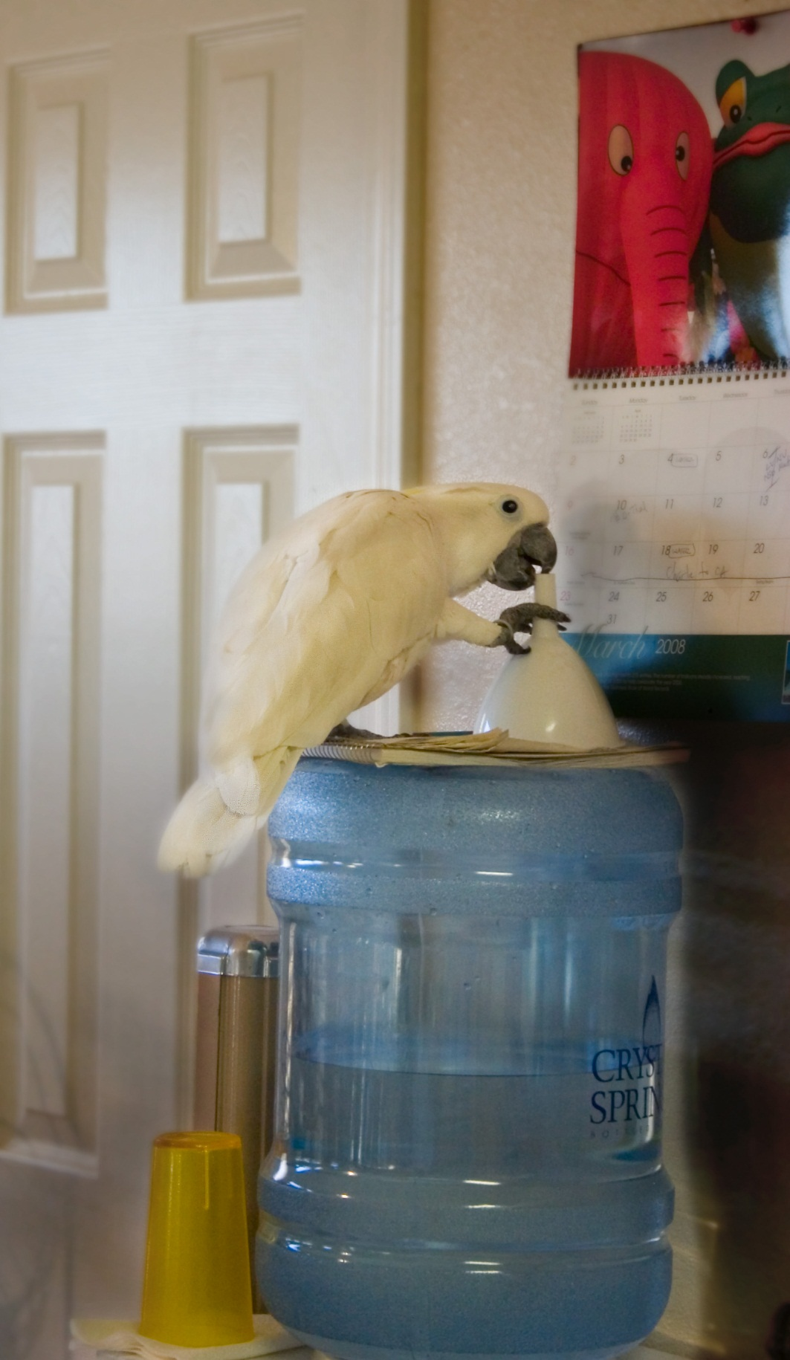
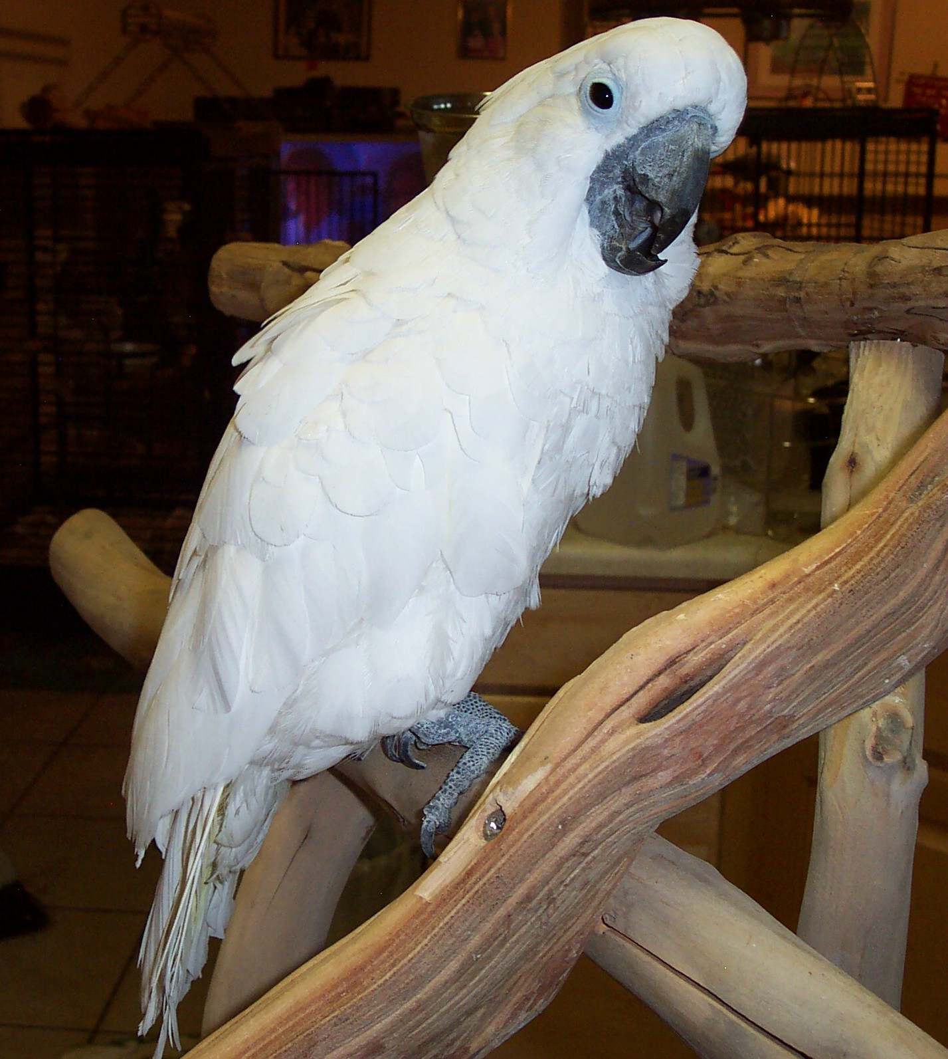
JASPER (Umbrella Cockatoo) and BUSTER (Eleanor Cockatoo)
Notes:
Jasper (Umbrella Cockatoo) and Buster (Eleanor Cockatoo)

Slide 21
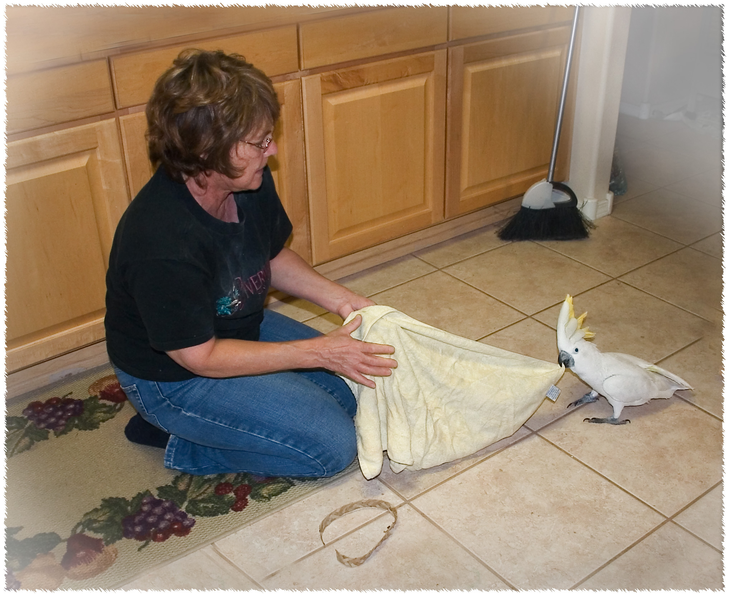
BUSTER’s tug-of-war
Notes:
BUSTER’s tug-of-war

Slide 22
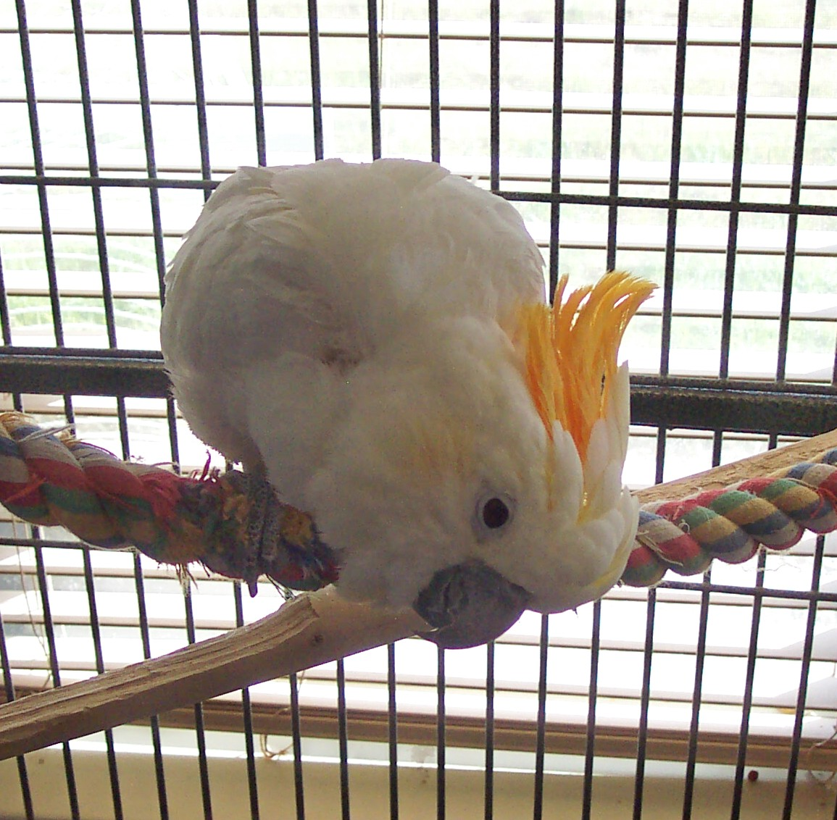
SUNSHINE (Citron Cockatoo)
Notes:
Sunshine (Citron Cockatoo)

Slide 23
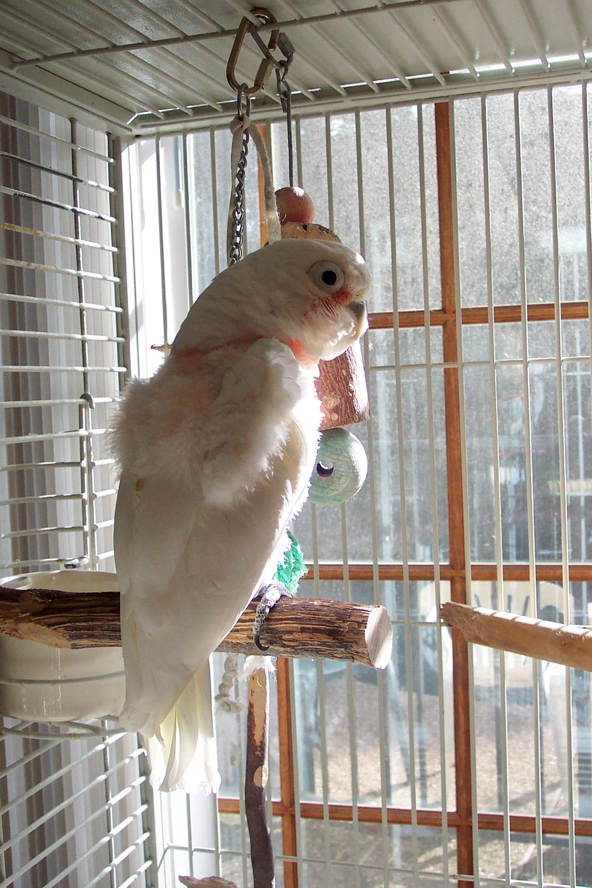
ROMEO (Goffin Cockatoo)
Notes:
ROMEO (Goffin Cockatoo)

Slide 24
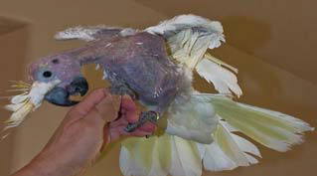
PISTASICO (Male Citron Cockatoo)

Slide 25
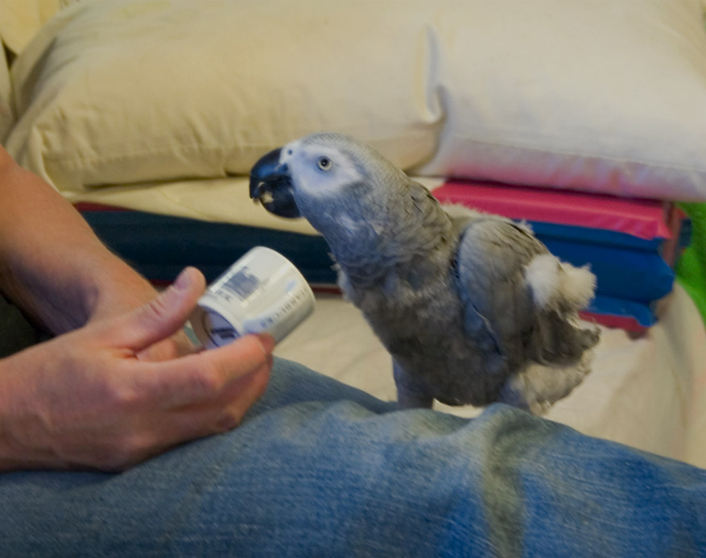
TUCKER (Congo African Grey)
Notes:
TUCKER (Congo African Grey)

Slide 26
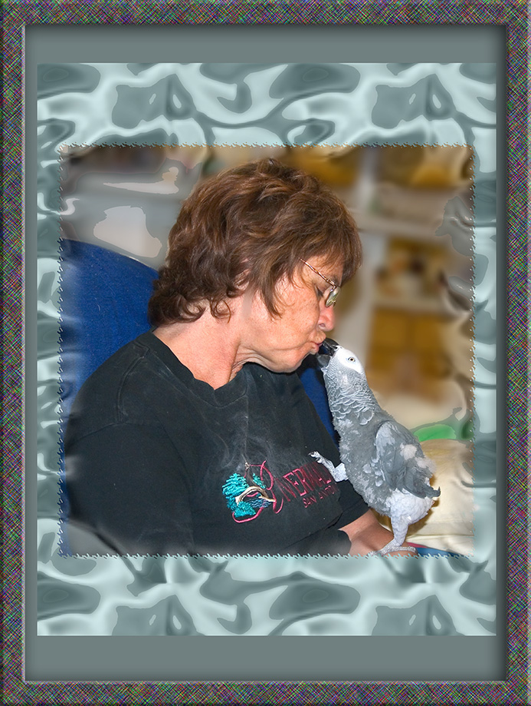
TUCKER – Loving time
Notes:
TUCKER – Loving time

Slide 27
KIRBY (Scarlet Macaw) – Talking to the Doc
Notes:
KIRBY (Scarlet Macaw) – Talking to the Doc

Slide 28
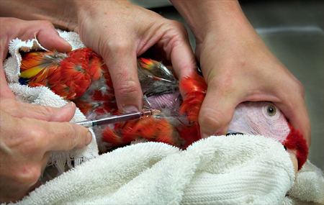
KIRBY – Giving some blood
Notes:
KIRBY – Giving some blood

Slide 29
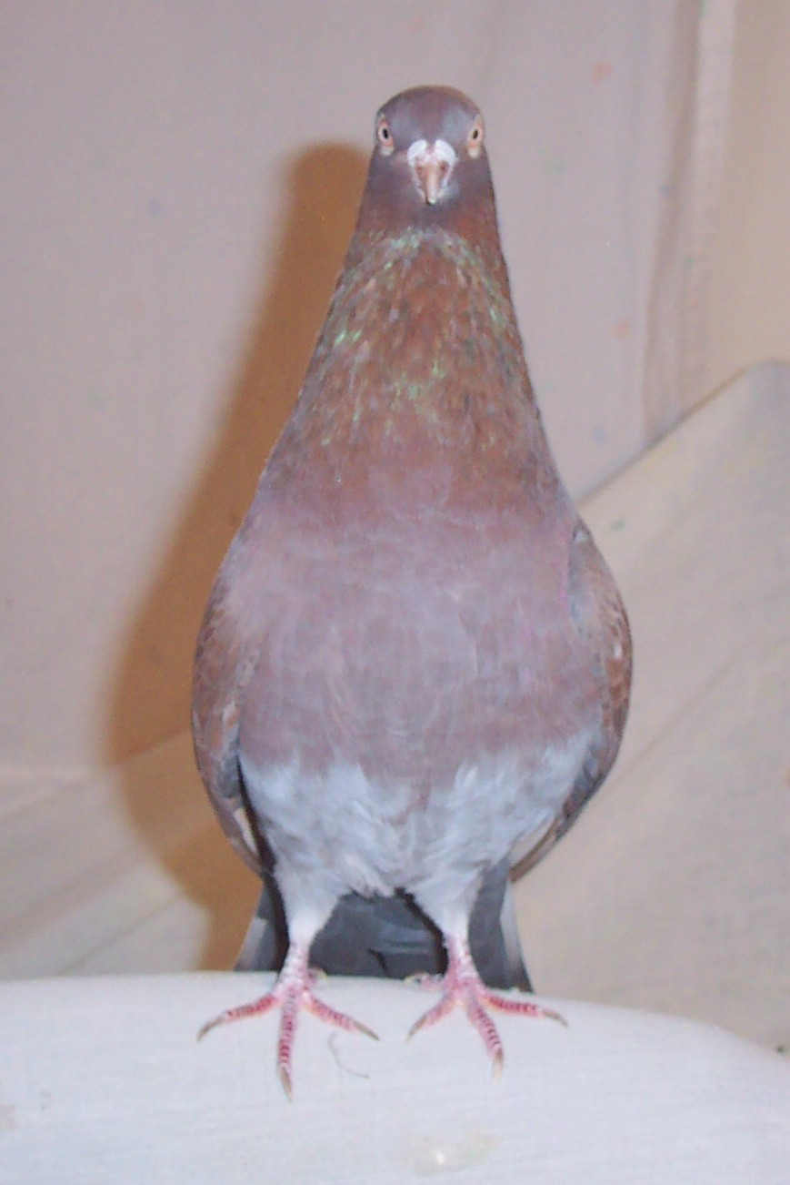
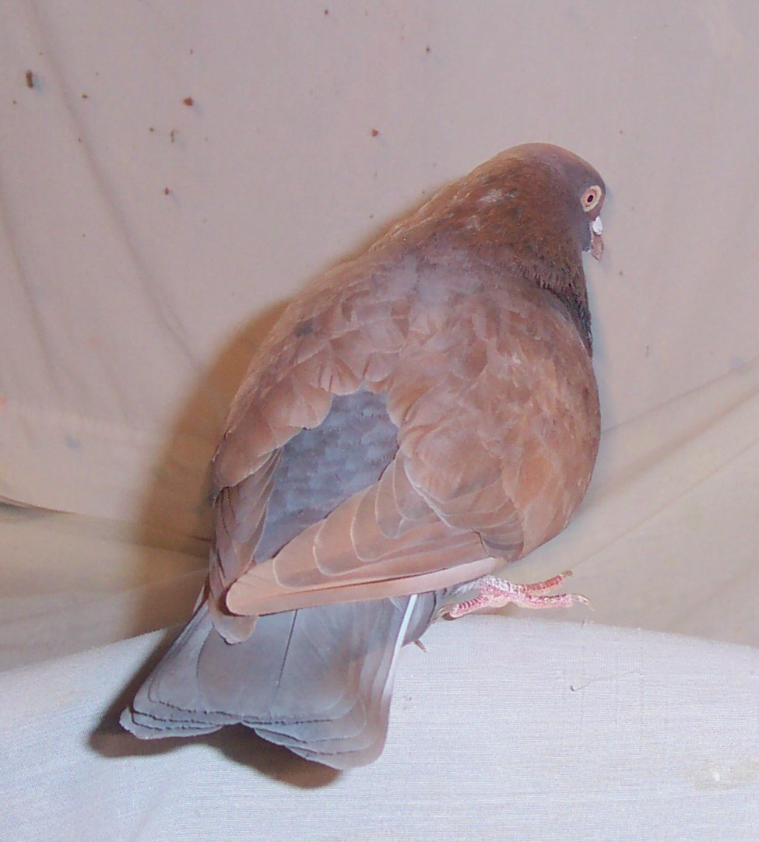
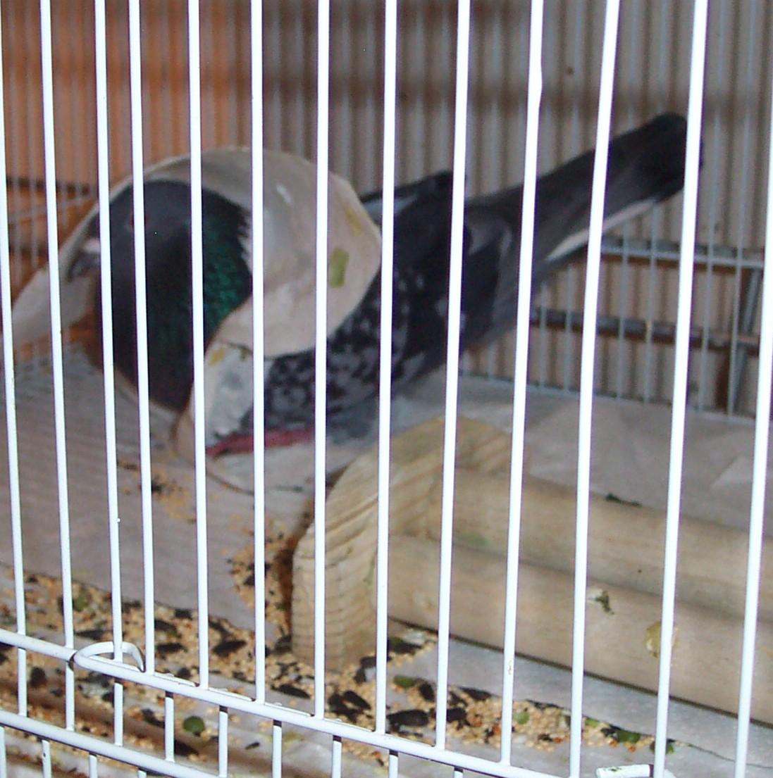
BUDDY (Red Spread Pigeon) – VAN DE GO (Grey Rock Pigeon)
Notes:
BUDDY (Red Spread Pigeon) – Van De Go (Grey Rock Pigeon)

Slide 30
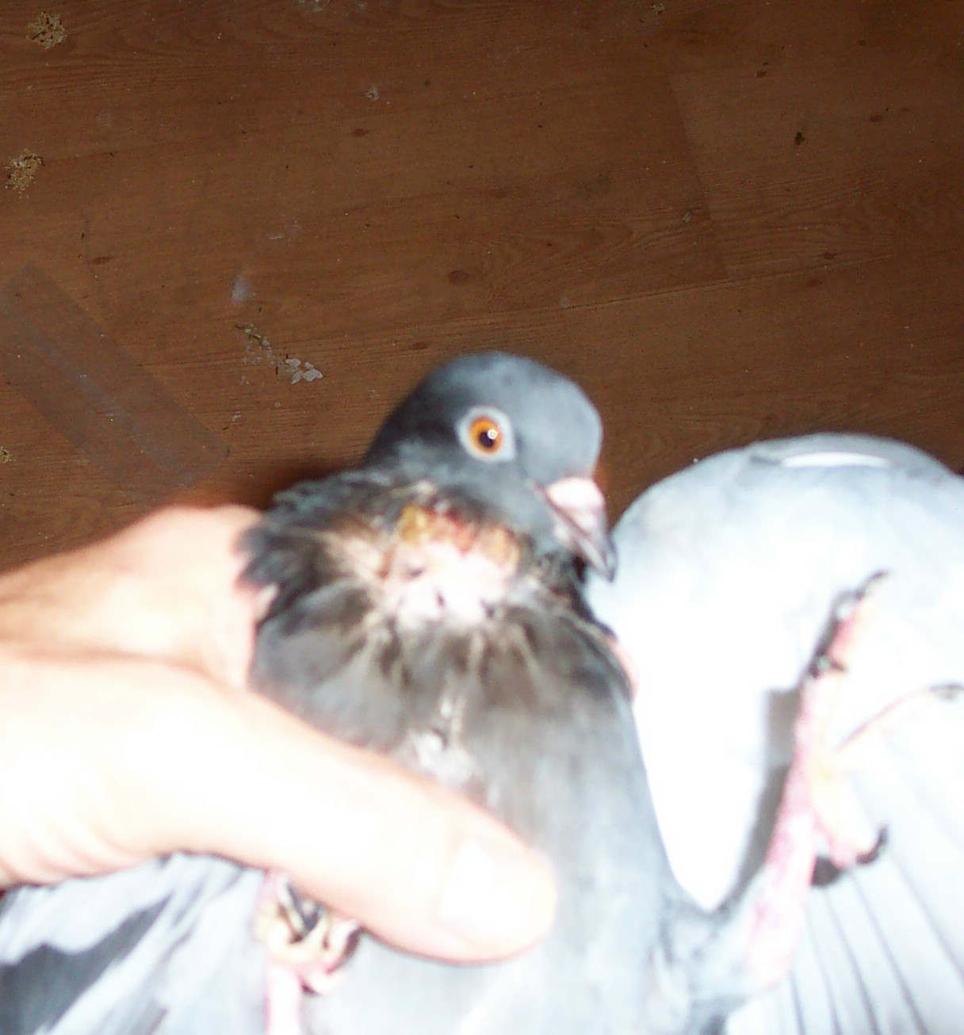
Throat cyst – Grey Rock Pigeon
Notes:
Throat cyst – Grey Rock Pigeon

Slide 31
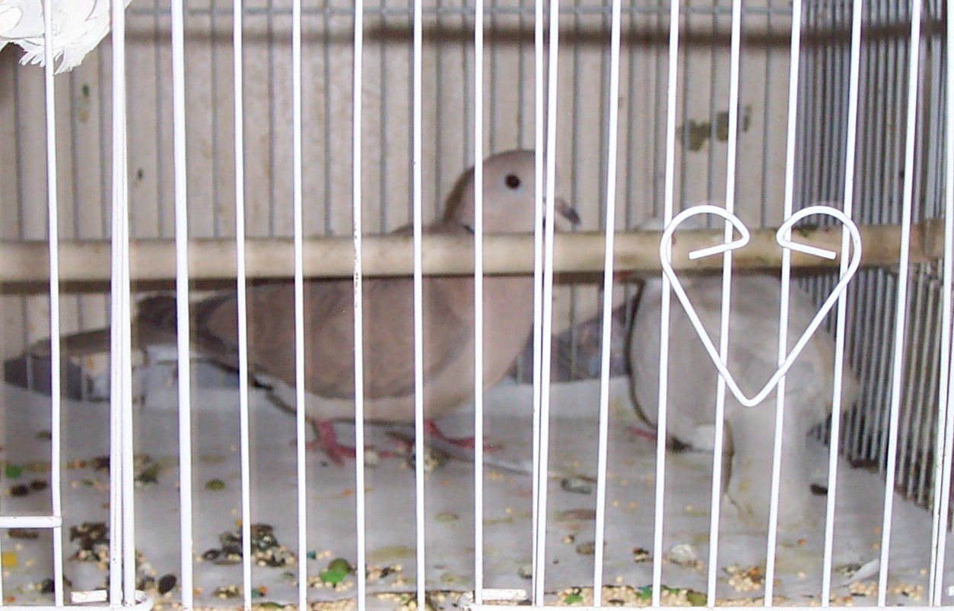
ANGEL (Ringneck Dove) and daughter CAMMIE (Albino Ringneck) – Representation only, Doves are NOT available for adoption.
Notes:
ANGEL (Ringneck Dove) and daughter (Cammie)

Slide 32
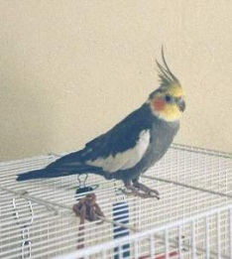
Grey Normal Male Cockatiel

Slide 33
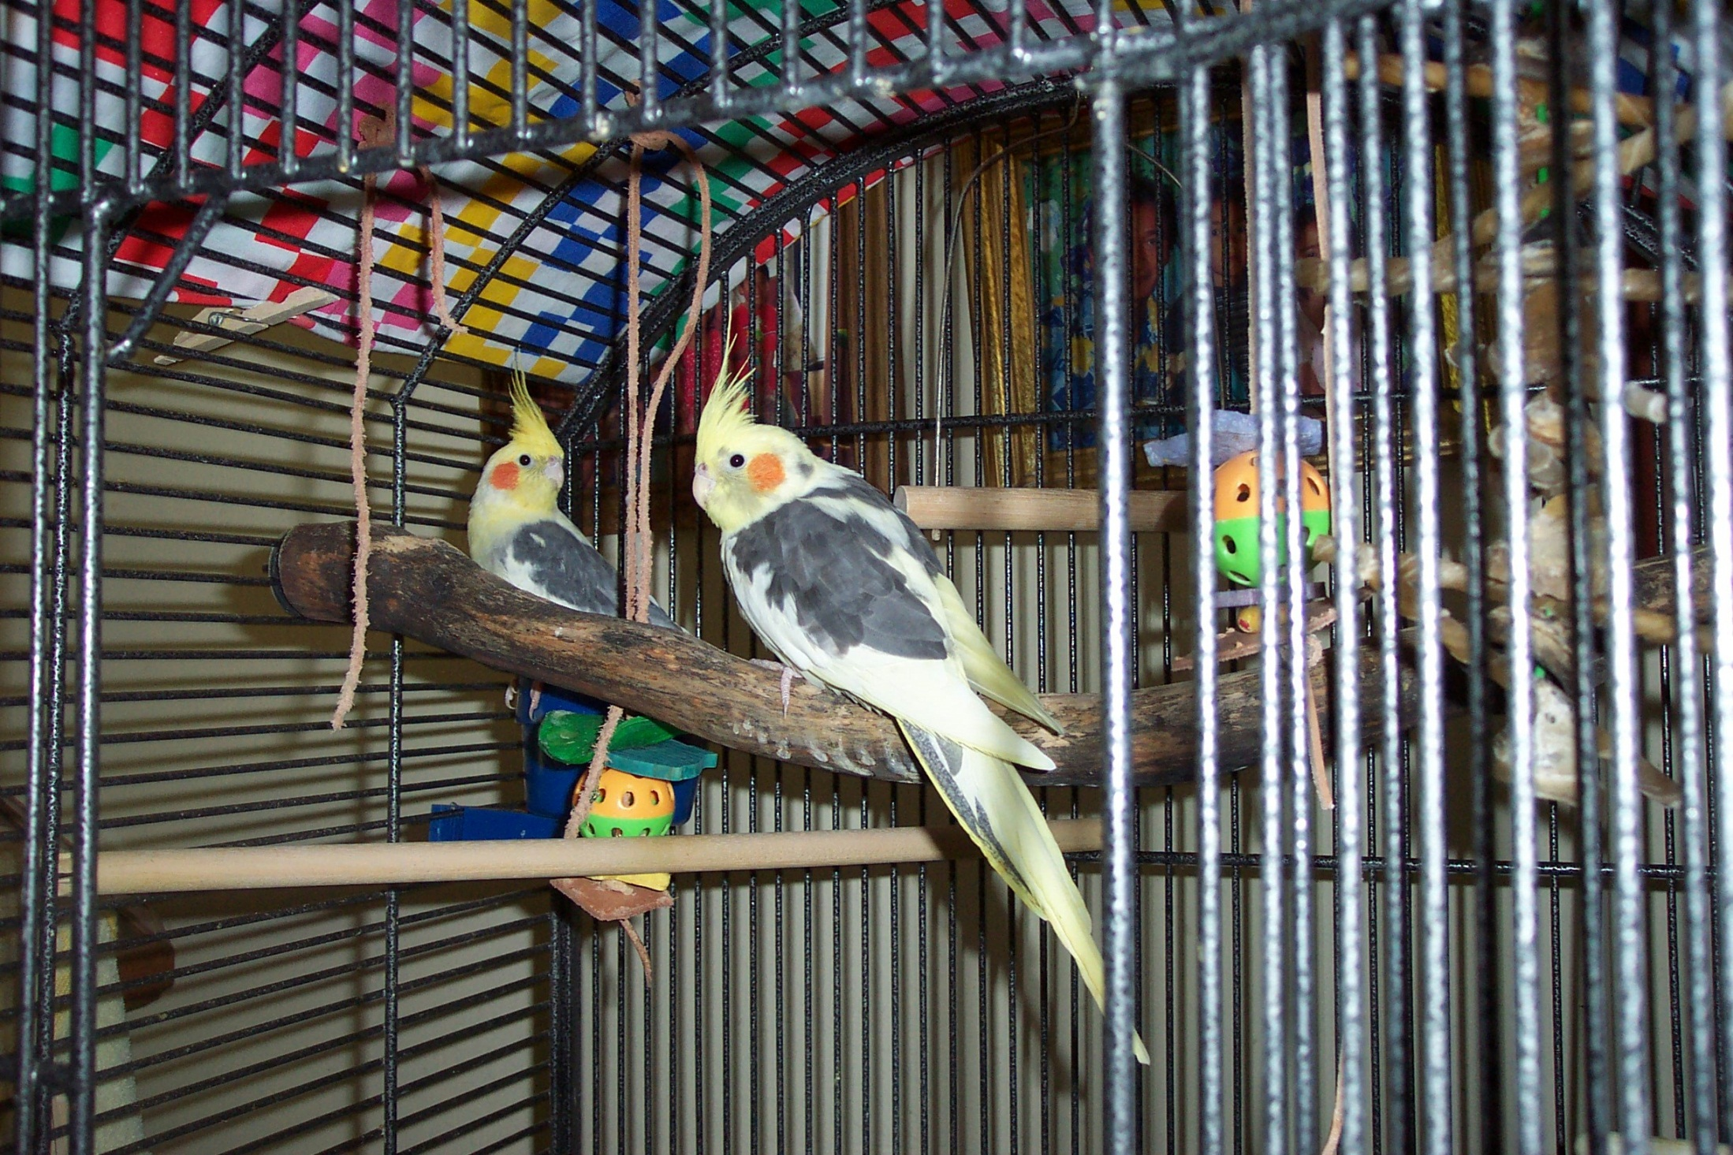
PIED Pair of Cockatiels

Slide 34
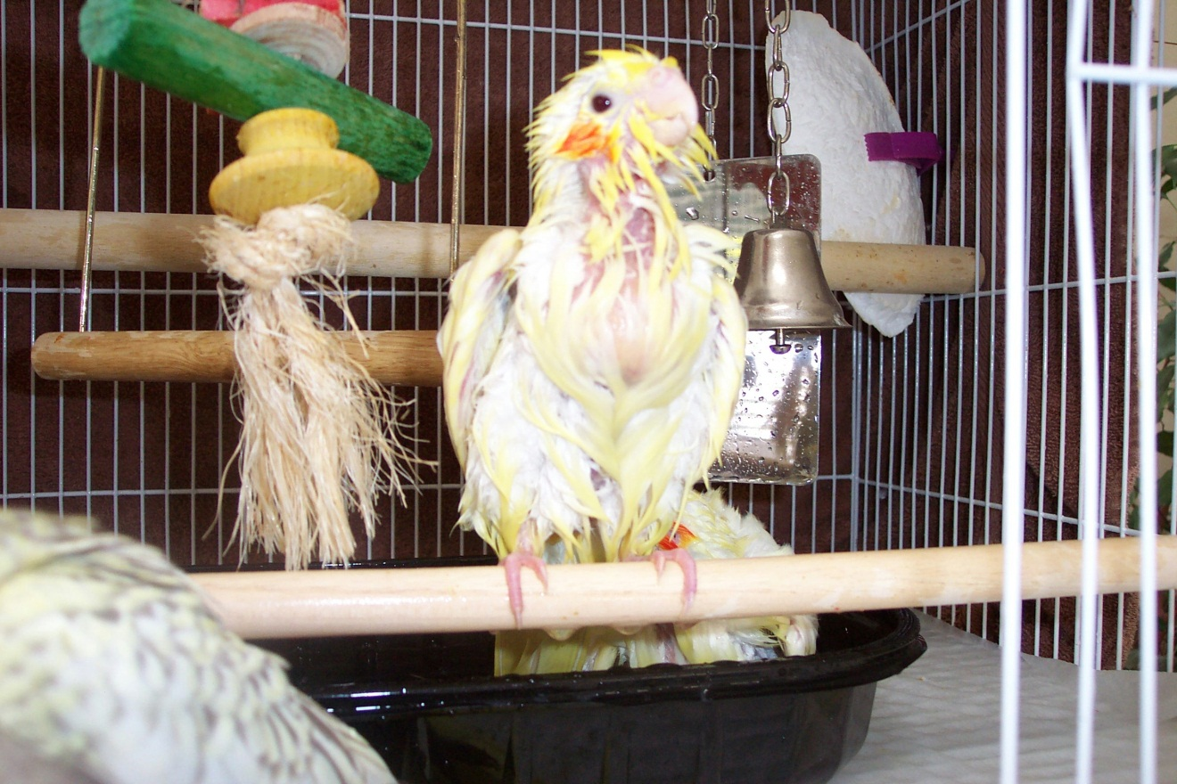
Birdie Bath Time !!

Slide 35
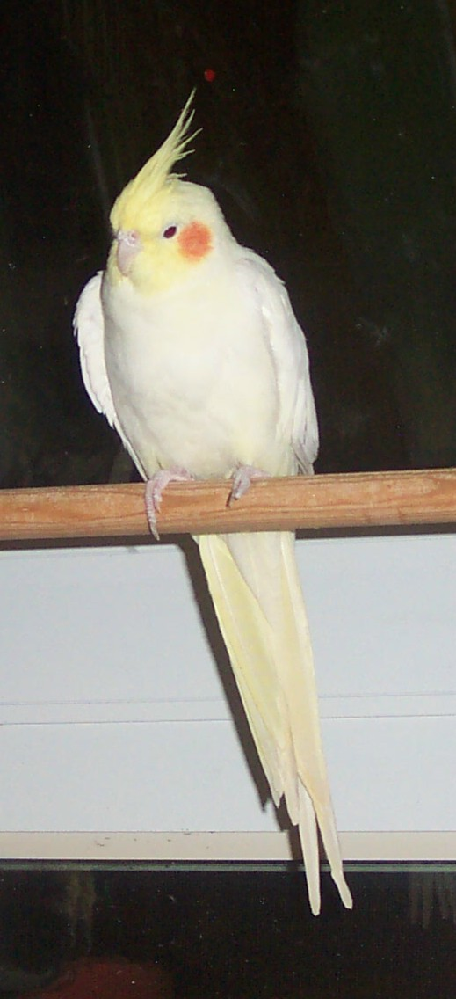
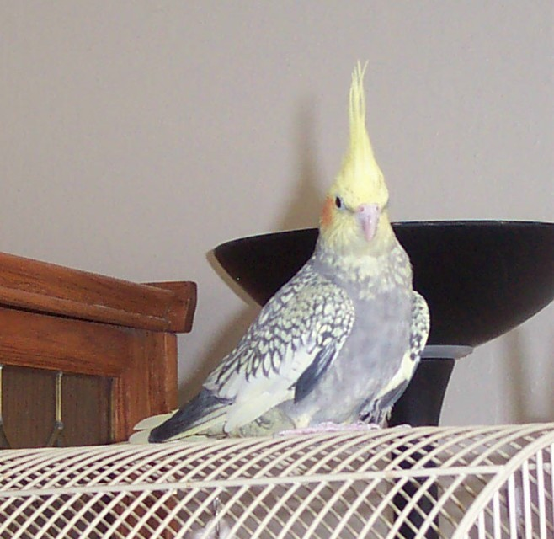
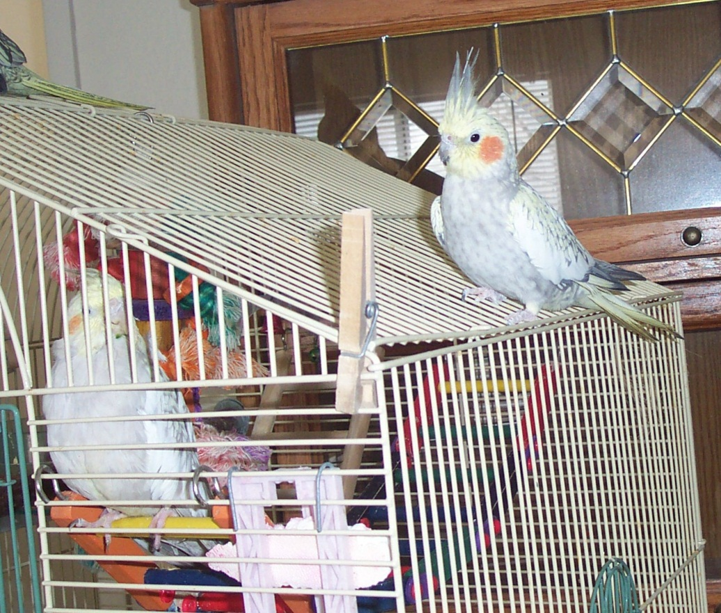
Some more of our kids
Notes:
Some of our kids

Slide 36
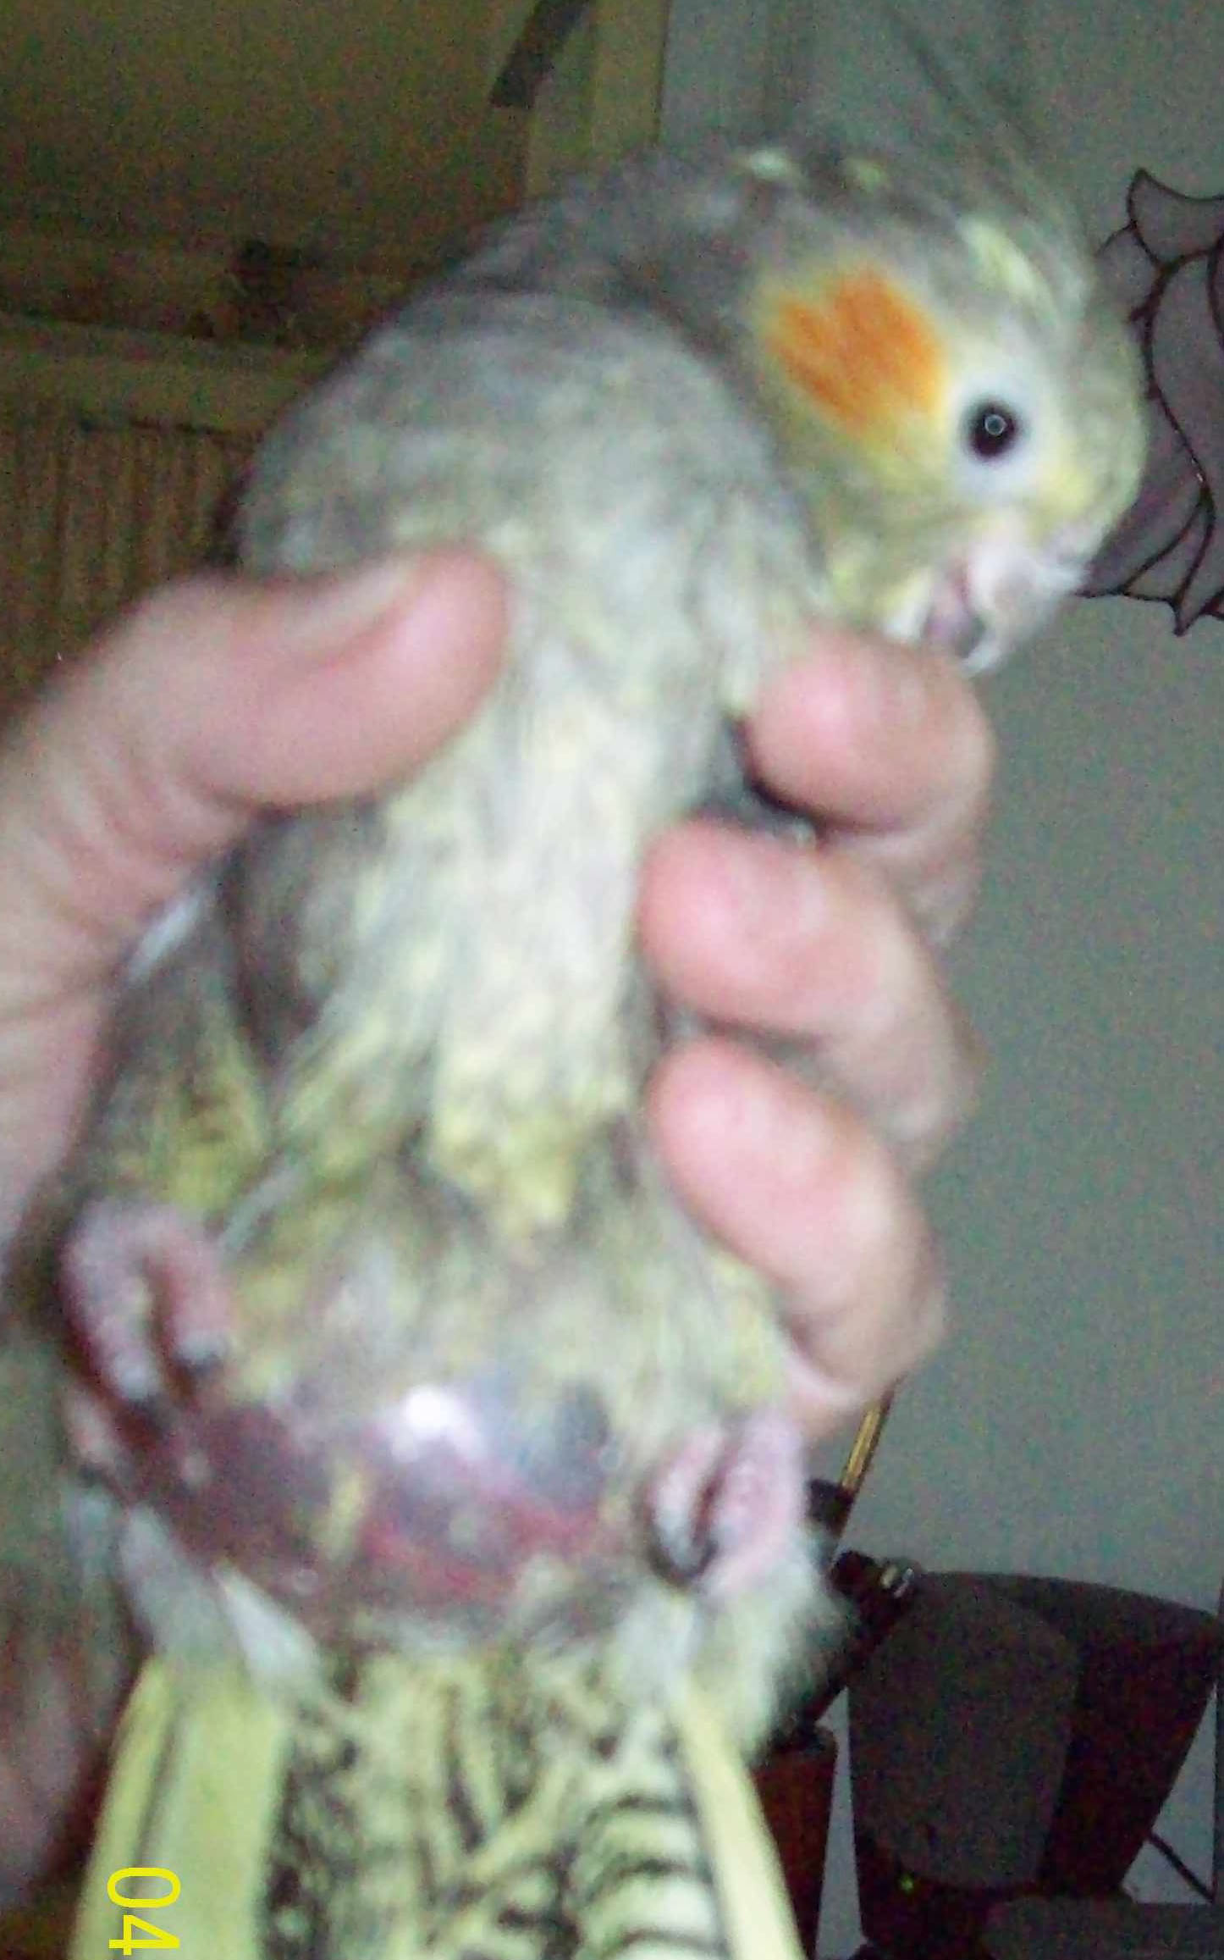
Cockatiel with crop fluid
Notes:
Cockatiel with crop fluid

Slide 37
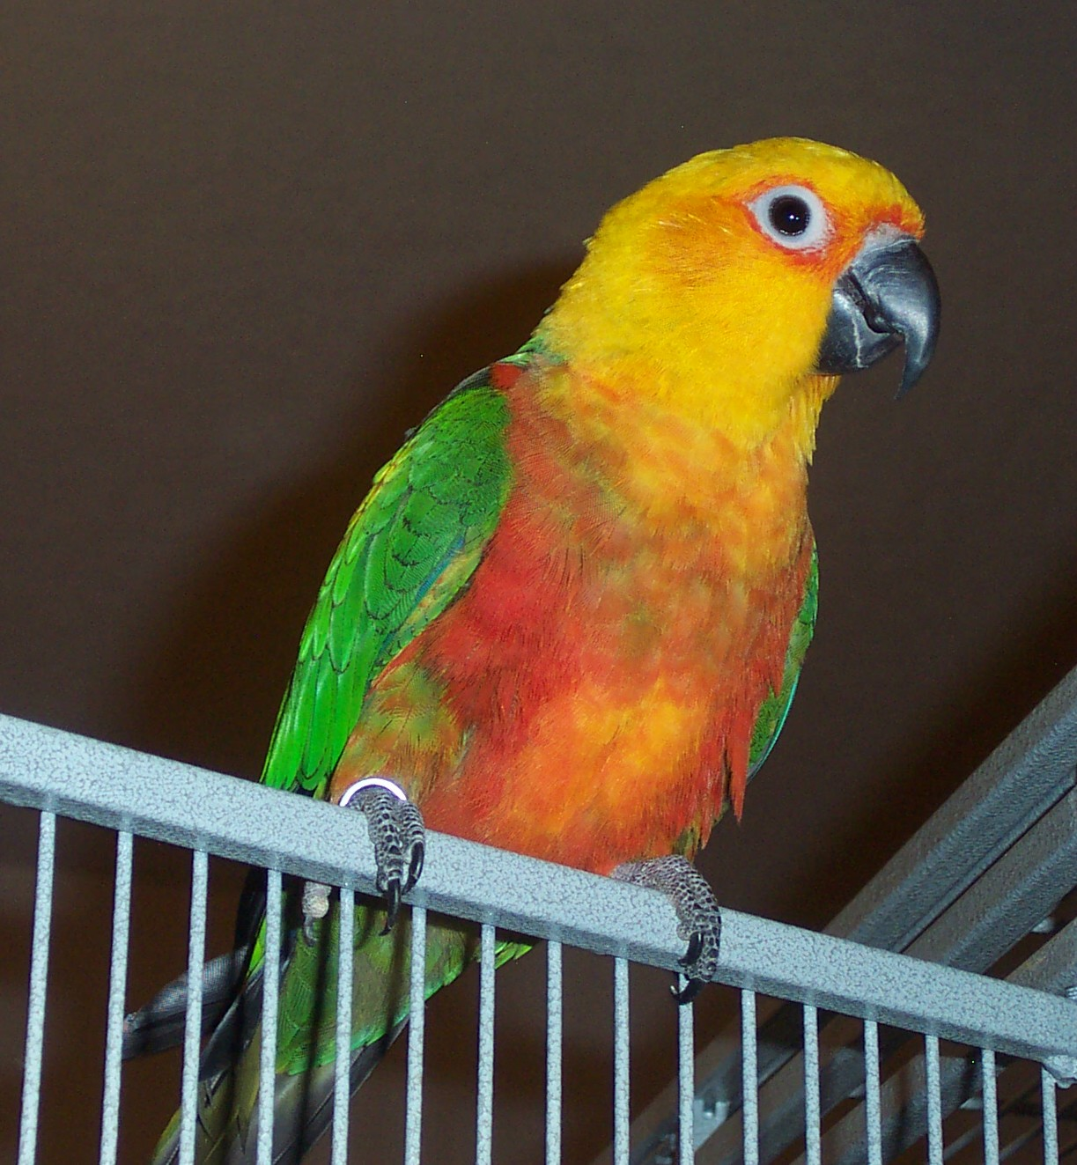
ZEEKE (Jenday Conure)
Notes:
Zeeke

Slide 38
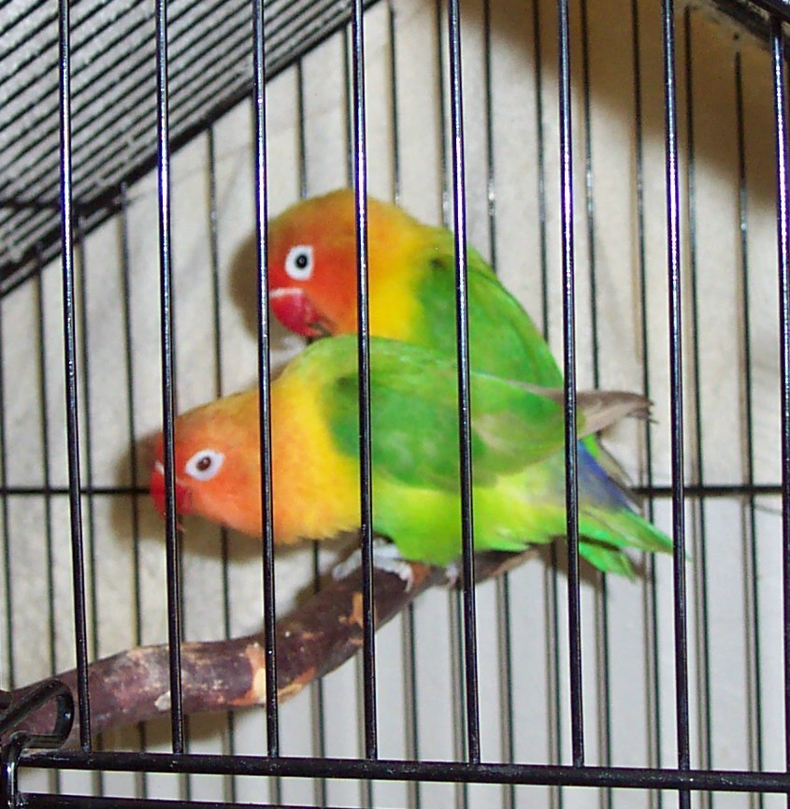
Fishers Lovebirds
Adopted

Slide 39
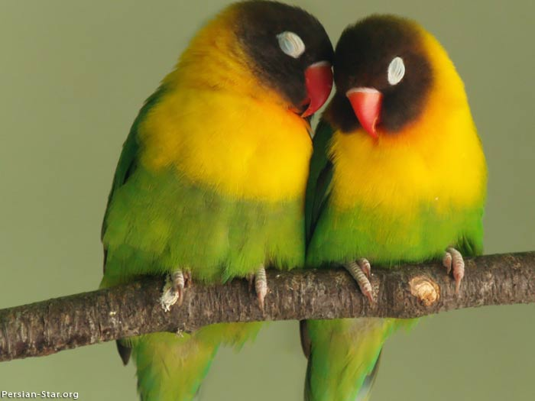
African Black Masked Lovebirds

Slide 40
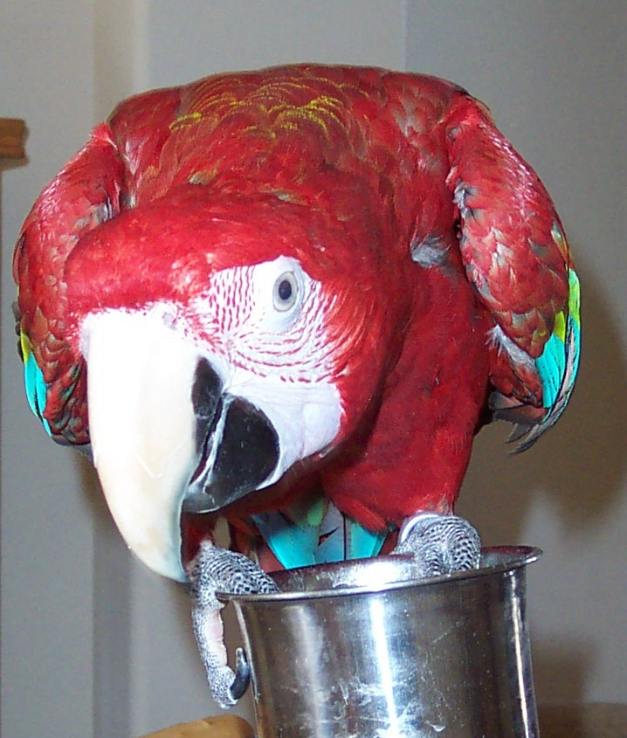
So – What’cha waiting for…help us NOW…
says JJ the Green Wing Macaw
Notes:
So – What’cha waiting for…help us NOW…says JJ the Green Wing Macaw

